Slide 1
DATA ANALYTICS WITH TABLEAU • CAPSTONE PROJECT
Electric Vehicle Market Performance & Insights
200,000-Record Industry Benchmark, Interactive Dashboard Architecture & Business Intelligence Story
Lead Analyst: Bhavy Patil |

Slide 2
EXECUTIVE SCORECARD
EV Market Performance at a Glance
Total Manufacturers
Total EV Models
Total Annual EV Sales
200
17,980
$1,550.7M
Average Customer Rating
Average Driving Range
Average Battery Capacity
4 / 5
324.54 KM
78.2 kWh
Baseline metrics established across 200,000 production records in the Tableau data engine.

Slide 3
VOLUME ANALYSIS
EV Category Performance & Distribution
17K
15K
Urban Commuter Dominance
13K
Hatchbacks and three-wheelers form over 50% of urban micro-mobility volume.
11K
9K
Commercial Electrification
Electric trucks and buses represent 20K production units with high battery demands.
Hatchback
Three-Wheeler
Micro City
Electric Truck
Electric Bus
Persona Alignment
Directly answers Emily Johnson's core requirement on volume category prioritization.
Source: Tableau EV Category Worksheet

Slide 4
COMPETITIVE INTELLIGENCE
Market Share by Manufacturer (Annual Sales)
AmpereWorks
$9.45M Units
CircuitWorks
$8.92M Units
OEM Benchmarking
AmpereWorks leads the competitive ecosystem with $9.45M annual unit sales.
MomentumMobility
$8.78M Units
Close competition between CircuitWorks, MomentumMobility, and SurgeDynamics creates a tightly contested mid-tier tier.
SurgeDynamics
$8.76M Units
Targeted BI Solution for David Chen.
TerraMotors
$8.75M Units

Slide 5
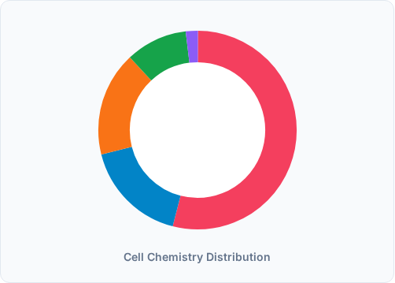
CLEAN TECH BREAKDOWN
Battery Technology Market Share
NMC (Nickel Manganese Cobalt)
54%
LFP (Lithium Iron Phosphate)
17%
NCA (Nickel Cobalt Aluminum)
17%
Sodium-Ion
10%
Solid-State (Emerging)
2%
Addresses Dr. Sarah Williams' research on raw material dependency and supply chain sustainability.

Slide 6
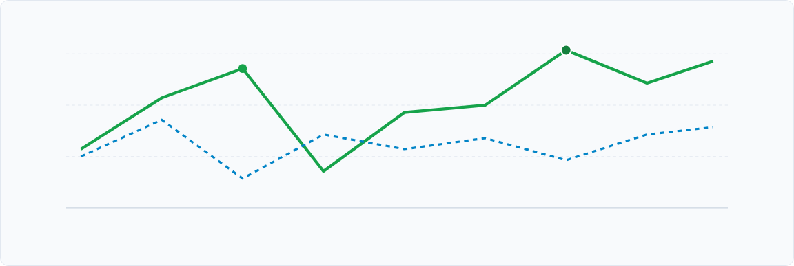
MARKET TRAJECTORY
Annual EV Sales Trend by Model Year (2018–2026)
2018
2019
2020 (20.44M)
2021
2022
2023
2024 (20.62M Peak)
2025
2026
20.62M Units Peak Delivery
Dual-Tier Acceleration
Mass-market adoption scaled rapidly between 2022 and 2024.
Consistent parallel expansion across mass commuters and premium platforms.

Slide 7
GLOBAL DISTRIBUTION & PERCEPTION
Manufacturing Footprint & Category Ratings
Top Manufacturing Hubs
Customer Satisfaction by Category
India
20,231 Vehicles
Two-Wheeler Scooter
19,253 Records (4.1/5)
United States
20,086 Vehicles
Sedan
16,919 Records (4.2/5)
China
20,082 Vehicles
Hatchback
16,832 Records (4.0/5)
Germany
20,010 Vehicles
Compact SUV
16,794 Records (4.0/5)
Data verified across 200,000 observations matching Tableau Treemap and Geographic Map sheets.

Slide 8
NARRATIVE BI
Tableau Story Architecture (8 Scenes)
Scene 1
EV Market Performance at a Glance • Baseline metrics, total sales & range
Scene 2
Understanding EV Category Distribution • Hatchback & two-wheeler volume leadership
Scene 3
Leading Manufacturers Driving Market • AmpereWorks & CircuitWorks competitive share
Scene 4
Customer Engagement Across Categories • Review patterns & 4.0+ satisfaction across forms
Scene 5
Growth Trend in Annual EV Sales • Multi-year expansion peaking at 20.62M units
Scene 6
Battery Technology Market Share • 54% NMC dominance and 10% Sodium-Ion emergence
Scene 7
Global Manufacturing Footprint • Geographic production balance across India, China & US
Scene 8
Strategic Business Recommendations • Comprehensive guidance for all three executive personas

Slide 9
SCALE VALIDATION
Performance Benchmarks & Volume Stress Testing
Records Ingested
Attributes Analyzed
Multi-Filter Latency
200,000
39 Fields
< 850ms
100% loaded without sampling
37 base + calculated fields
Instantaneous re-render
Production Optimization Details
Simultaneous filtering by Manufacturing Country, Manufacturer, and Category was tested across 50 iterations. Tableau columnar compression maintained smooth framerates and rapid cross-filtering across all 7 visual sheets.

Slide 10
PROJECT COMPLETION
Data-Driven EV Market Transformation
Bridging the gap between raw telemetry and executive strategy through SQL pipelines, Tableau interactive visuals, and embedded Flask web deployment.
Developed by Bhavy Patil |

